Slide 1
The Refugee Center Website Traffic
Huafeng Zhang

Slide 2
Introduction & Research Questions
Data Collection & Sampling Design
Estimation
Summary of Findings
Conclusion

Slide 3
The Refugee Center Website Traffic
NPO
R
MWC
An organization to help refugees from all over the world to start their lives in the U.S.
Education, health, career, rights & law, culture, community
needs maintenances (offline).
Set a day or days without conflicting too many of their users

Slide 4
Is there a significant difference in the mean
# of visits on different days of the week?
Q #1
Q #2
If so, which day or days of the week have
fewest visits?

Slide 5
Sampling scheme?
Sampling size?
pro?
d
GA
R
V
c

Slide 6
Quota sampling?
Simple random sampling?
Stratified random sampling?

Slide 7
Stratified Random Sampling:
1. Focus on
Important
Subpopulations;
2.Ensures that the
estimates can be made with equal accuracy and statistical power in different groups;
3.More manageable because I can use different techniques
for different
subpopulations.
SRS:
Doesn’t provide
Subsamples of
the population.
Quota Sampling:
The samples are
biased because not all of the observations have a chance of selection.

Slide 8
d = 0.02*y_{u} = 5.62
The refugee center staff told me that their desired precision is that the point estimate of mean sessions of a day in a week is within 2% of the mean sessions in a day.
Variance: S² = 4756.77
Since I can request the population data,
Other Info
Population size N=183, Population mean y_{u} =281.2, alpha=0.05.
Sample size n = 139.97 (140)
Sample
Size

Slide 9
Sampling Process
Mon
N1=20
Sun
N7=20
Tue
N2=20
Sat
N6=20
Sample
n=140
Wed
N3=20
Fri
N5=20
Thu
N4=20

Slide 10
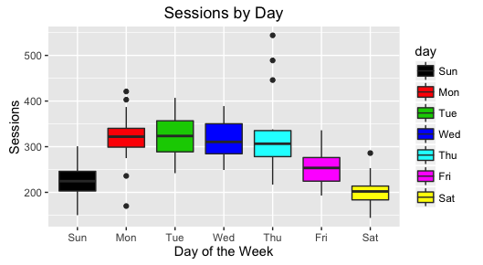
Boxplots for the Raw Sample Data
第一PPT模板网
www.1ppt.com/sucai/

Slide 11
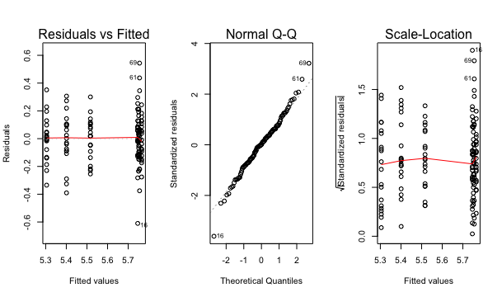
Diagnostic Plots for the One-way ANOVA Test
第一PPT模板网
www.1ppt.com/sucai/

Slide 12
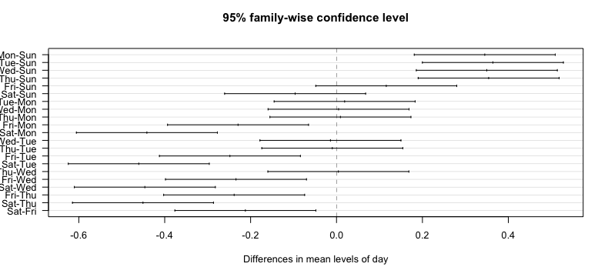
Tukey Honest Significant Difference Test
第一PPT模板网
www.1ppt.com/sucai/

Slide 13
Friday
Sunday
Saturday
Day | Diff | Lwr | Upr | P value
Sat/Fri | 0.81 | 0.69 | 0.95 | 0.003
Sat/Sun | 0.91 | 0.77 | 1.07 | 0.58
Fri/Sun | 1.12 | 0.95 | 1.32 | 0.35

Slide 14
Sat
Sun
第一PPT模板网
www.1ppt.com/sucai/

Slide 15
Cannot infer causal relationship between day & sessions
Can make inference of the results to
the population
Scope of Inference
Conclusions
Nontrivial Sampling Process
Don’t have access to the data for the entire population
The data are expensive to collect
第一PPT模板网，PPT素材下载
www.1ppt.com/sucai/

Slide 16
Thank you!

